Slide 1
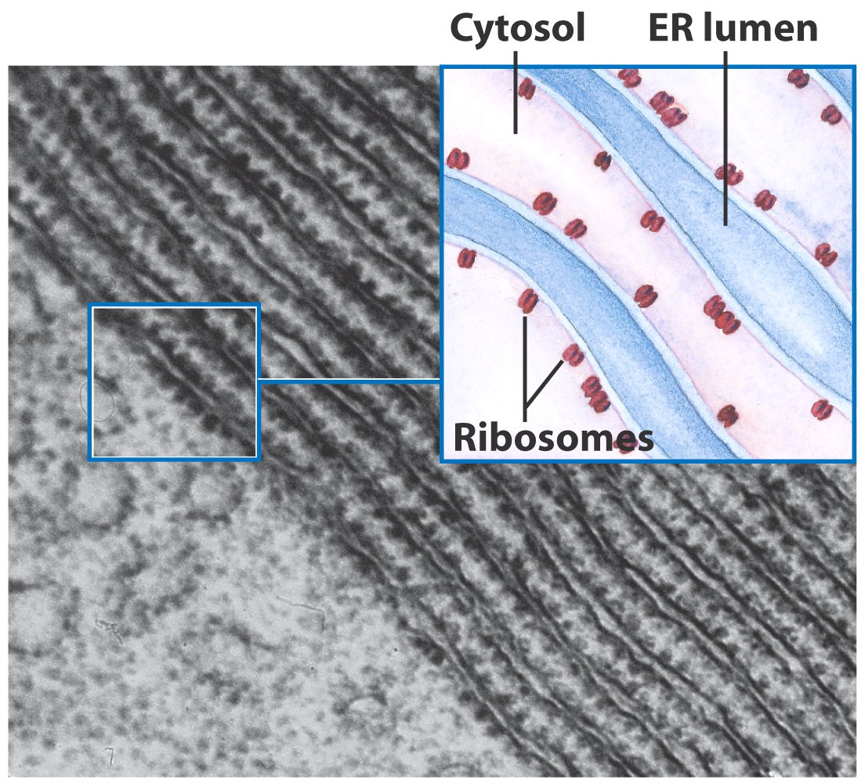
Translation
From RNA to Protein
Ribosomes are here the protein synthesized in the cells

Slide 2
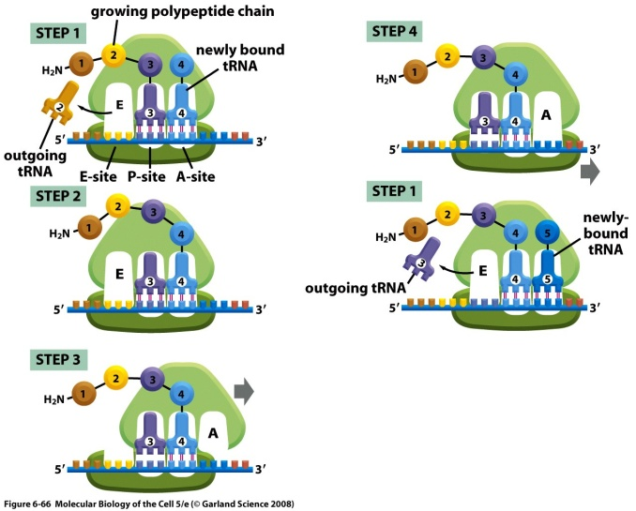
Steps of Translation

Slide 3
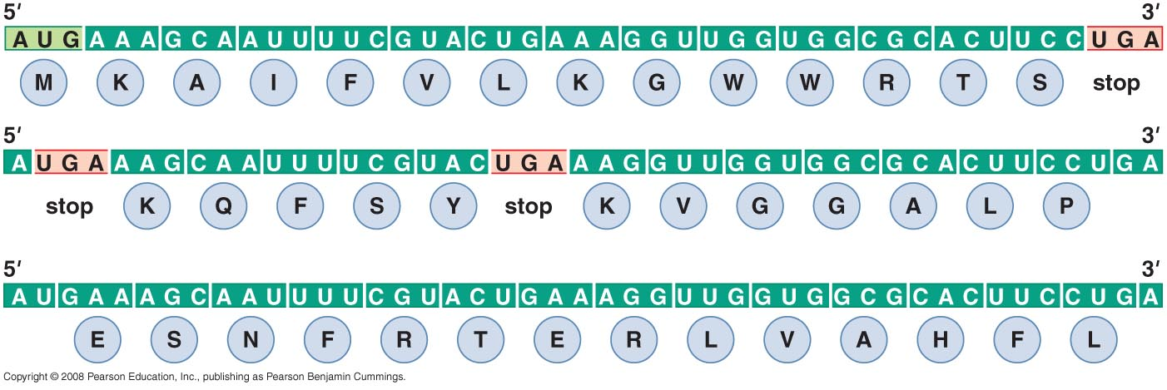
MESSENGER RNA
Polypeptide chains are specified by open reading frames
Three possible reading frames of E. coli trp leader sequence

Slide 4
An mRNA sequence is decoded in set of three nucleotides
The standard one-letter abbreviation for each amino acid is presented below its three-letter abbreviation (see Panel 3–1, pp. 132–133, for the full name of each amino acid and its structure). By convention, codons are always written with the 5'- terminal nucleotide to the left. Note that most amino acids are represented by more than one codon, and that there are some regularities in the set of codons that specifies each amino acid. Codons for the same amino acid tend to contain the same nucleotides at the first and second positions, and vary at the third position. Three codons do not specify any amino acid but act as termination sites (stop codons), signaling the end of the protein- coding sequence. One codon—AUG—acts both as an initiation codon, signaling the start of a protein-coding message, and also as the codon that specifies methionine.

Slide 5
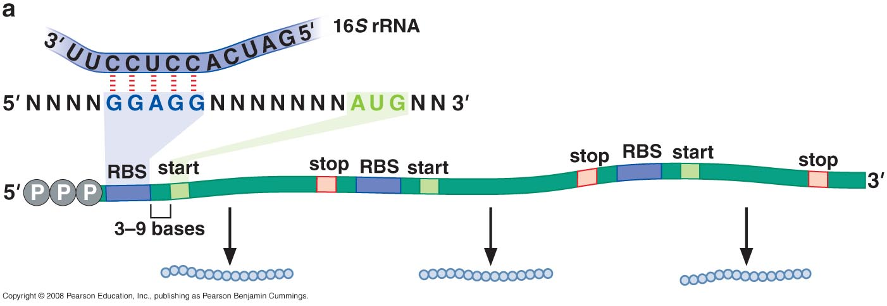
Prokaryotic mRNAs have a ribosome-binding site that recruits the translational machinery

Slide 6
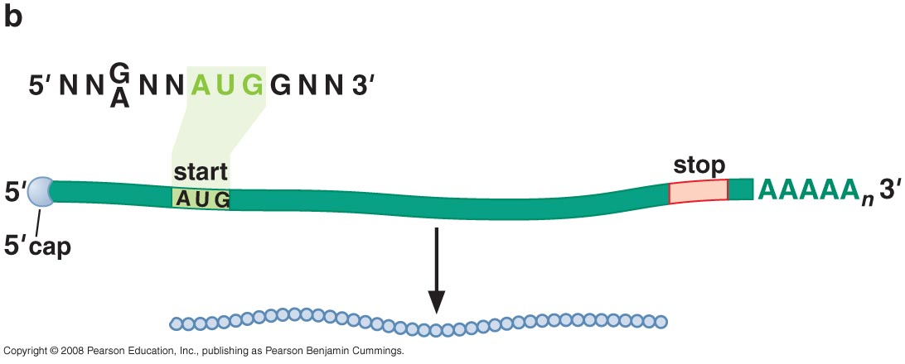
Eukaryotic mRNAs are modified at their 5’ and 3’ ends to facilitate translation

Slide 7
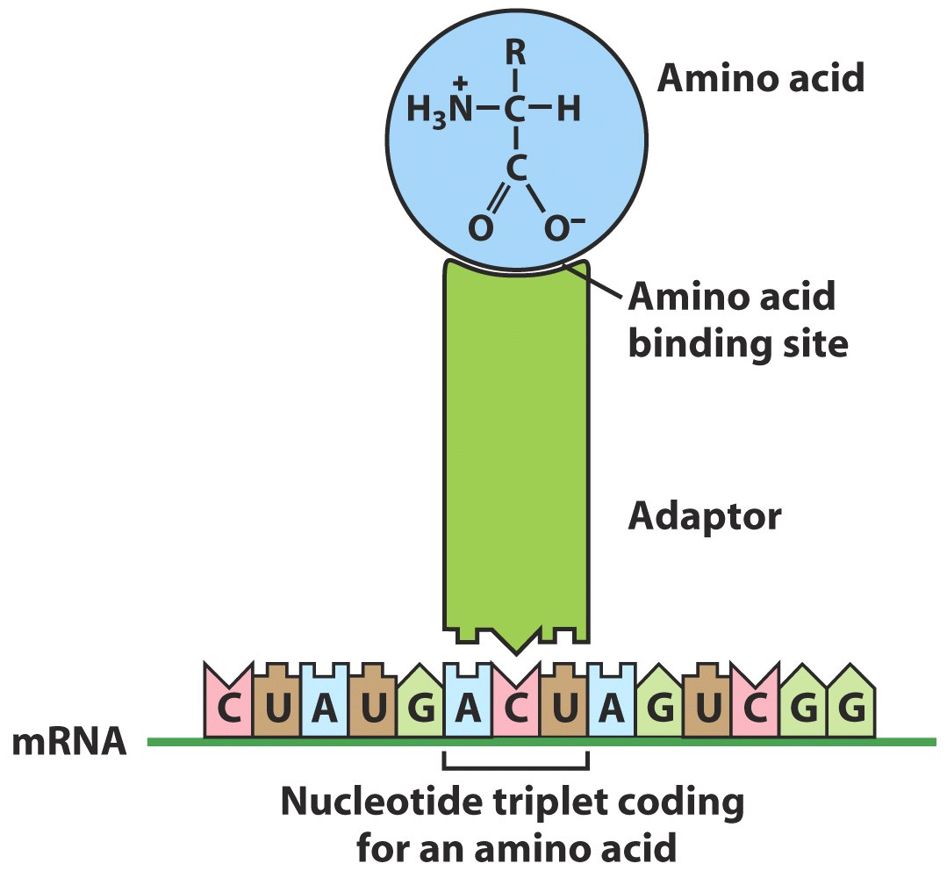
TRANSFER RNA
tRNA molecules match amino acids to codons in mRNA
Crick’s adaptor hypothesis

Slide 8
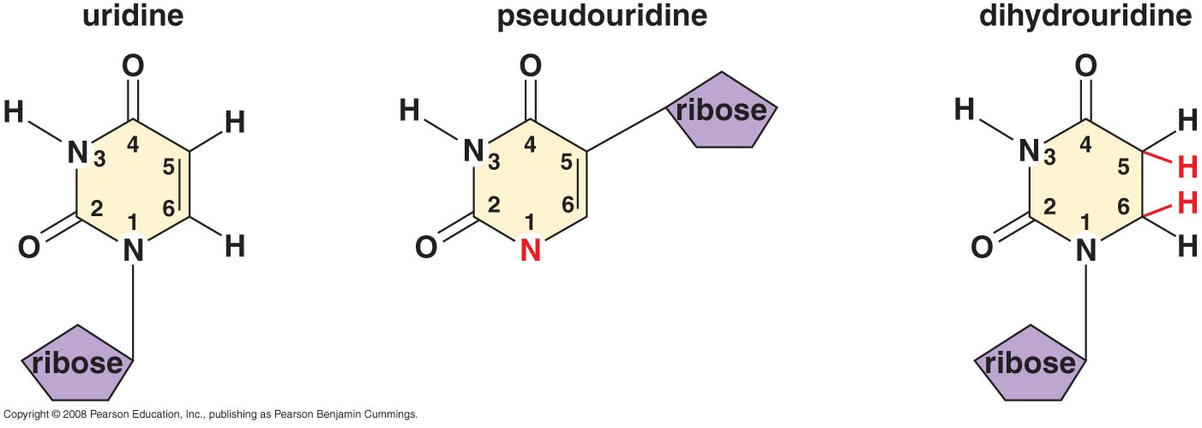
A subset of modified nucleotides found in tRNA

Slide 9
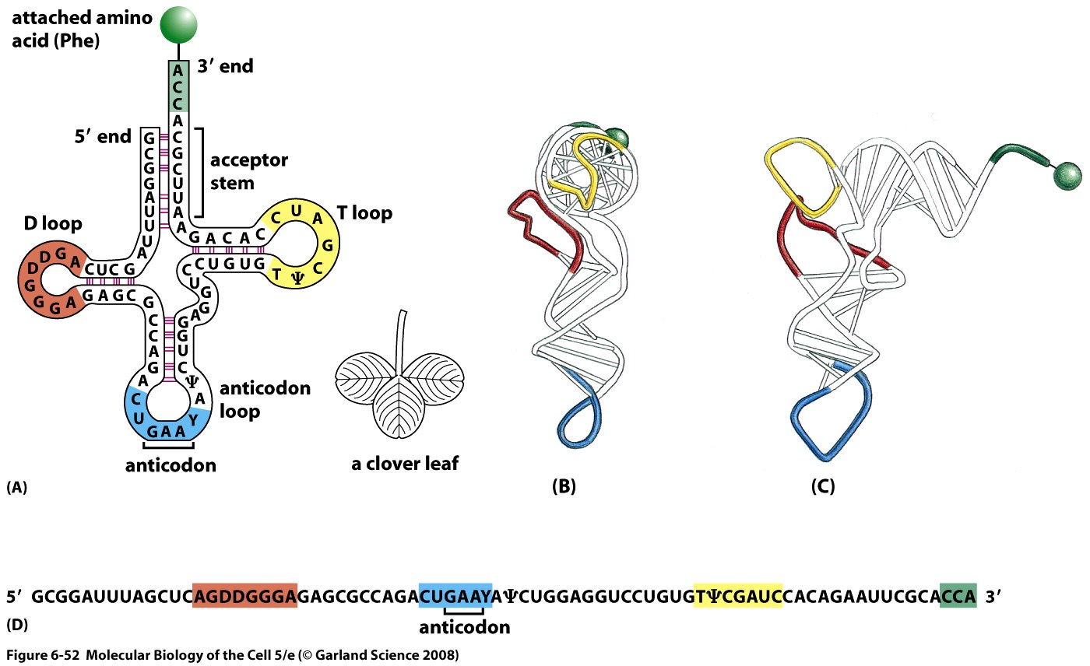
tRNAs share a common secondary structure that resembles a cloverleaf
The anticodon is the sequence of three nucleotides that base-pairs with a codon in mRNA. The amino acid matching the codon/anticodon pair is attached at the 3' end of the tRNA. tRNAs contain some unusual bases, which are produced by chemical modification after the tRNA has been synthesized. For example, the bases denoted y and D are derived from uracil. (B and C) Views of the actual L-shaped molecule, based on x-ray diffraction analysis. Although a particular tRNA, that for the amino acid phenylalanine, is depicted, all other tRNAs have very similar structures. (D) The linear nucleotide sequence of the molecule, color-coded to match A, B, and C.

Slide 10
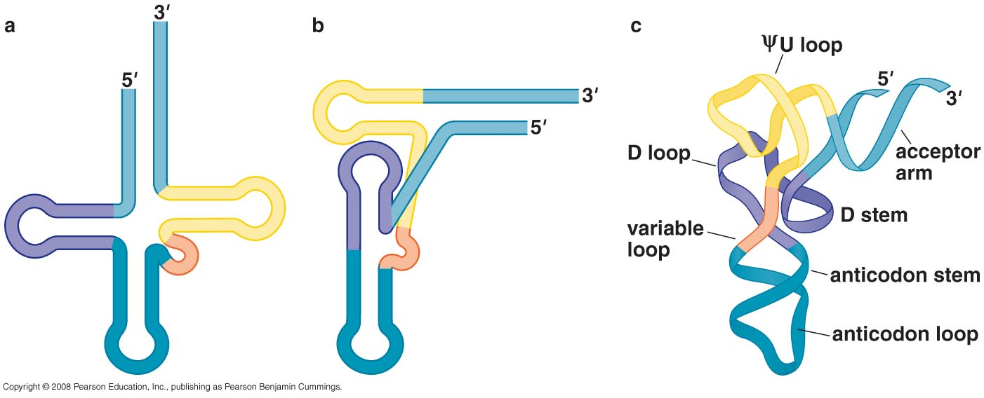
tRNAs have an L-shaped 3 dimensional structures

Slide 11
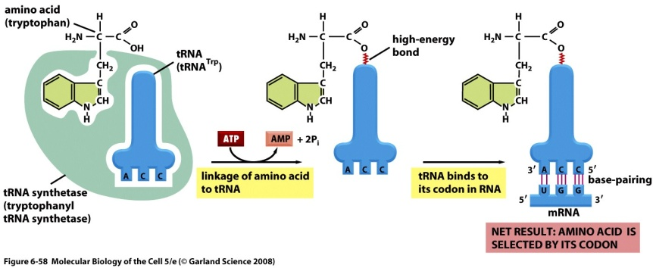
ATTACHMENT OF AMINO ACIDS TO tRNA
tRNAs are charged by attachment of an AA to its 3’ terminal

Slide 12
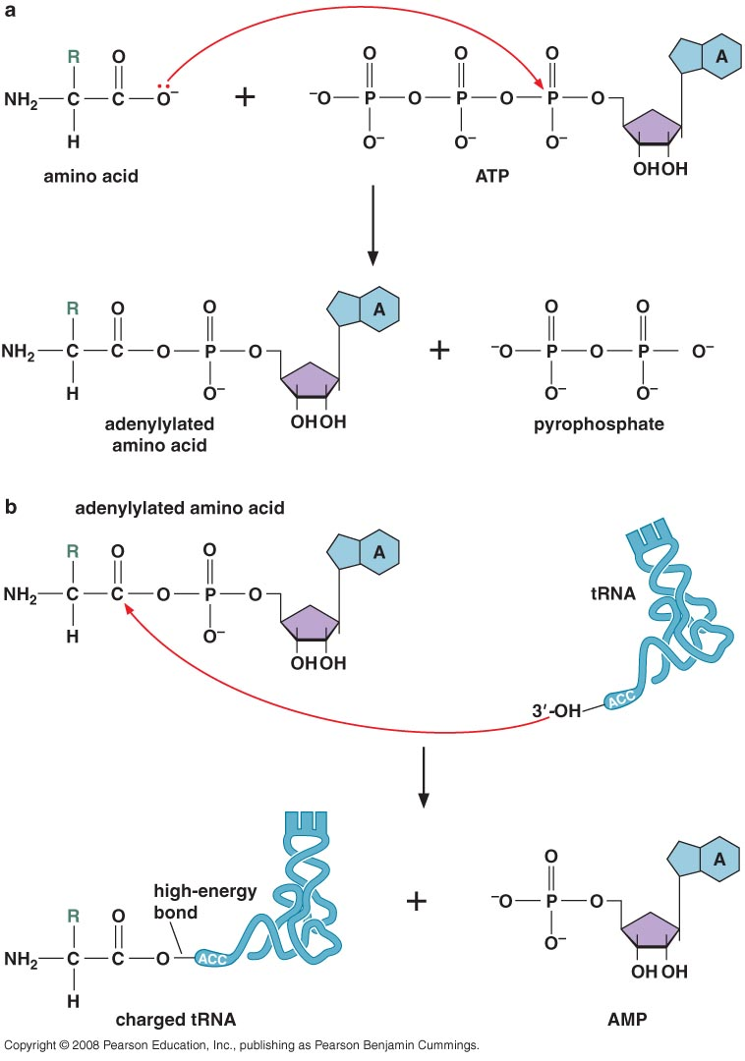
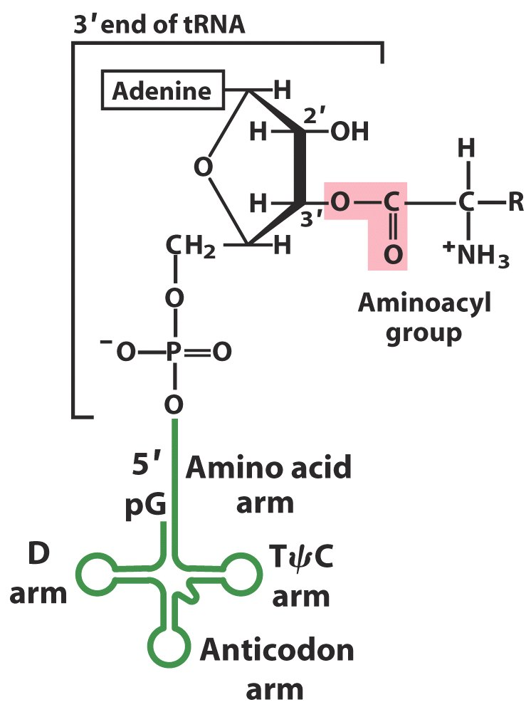
Aminoacyl-tRNA synthetases charge tRNAs in two steps

Slide 13
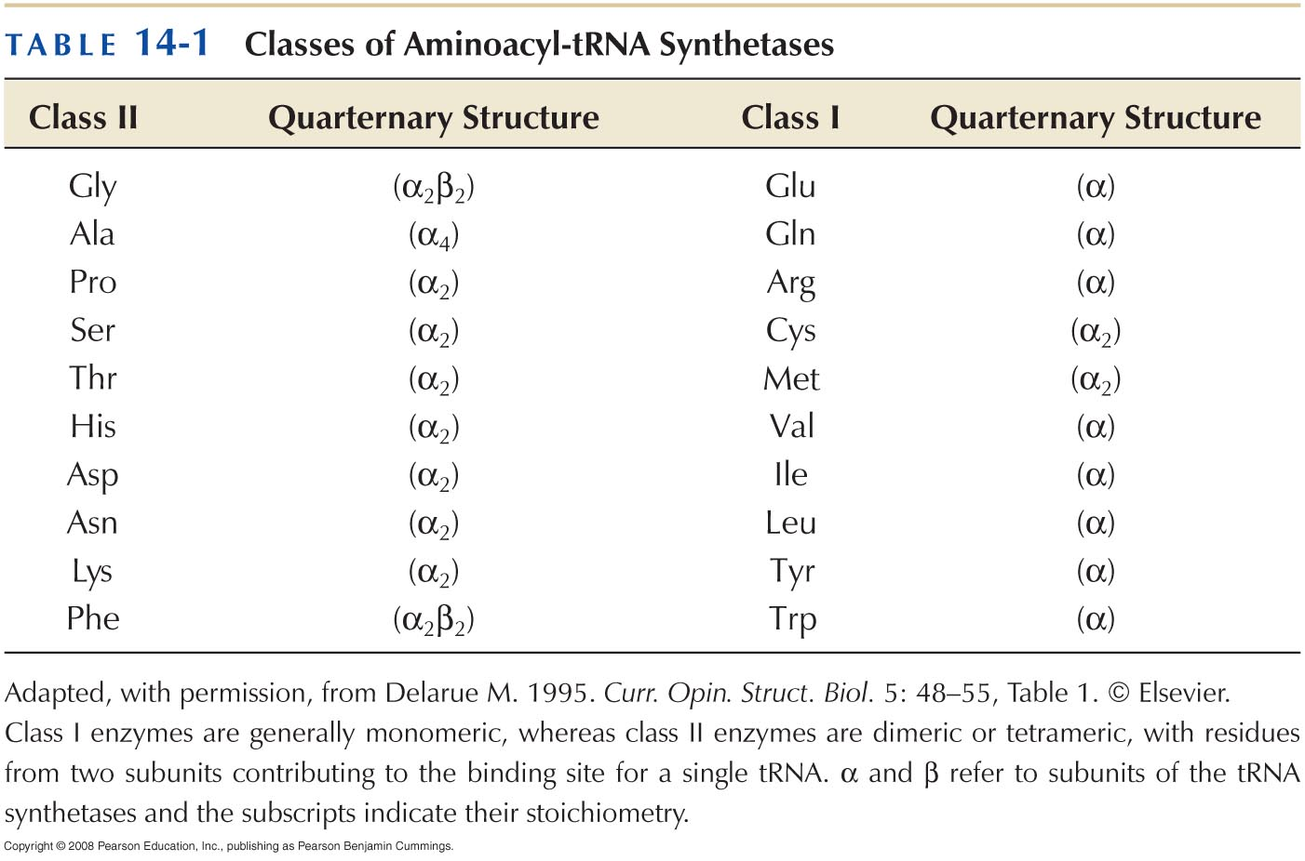
Each aminoacyl-tRNA synthetase attaches a single amino acid to one or more tRNAs

Slide 14
An mRNA sequence is decoded in set of three nucleotides
The standard one-letter abbreviation for each amino acid is presented below its three-letter abbreviation (see Panel 3–1, pp. 132–133, for the full name of each amino acid and its structure). By convention, codons are always written with the 5'- terminal nucleotide to the left. Note that most amino acids are represented by more than one codon, and that there are some regularities in the set of codons that specifies each amino acid. Codons for the same amino acid tend to contain the same nucleotides at the first and second positions, and vary at the third position. Three codons do not specify any amino acid but act as termination sites (stop codons), signaling the end of the protein- coding sequence. One codon—AUG—acts both as an initiation codon, signaling the start of a protein-coding message, and also as the codon that specifies methionine.

Slide 15
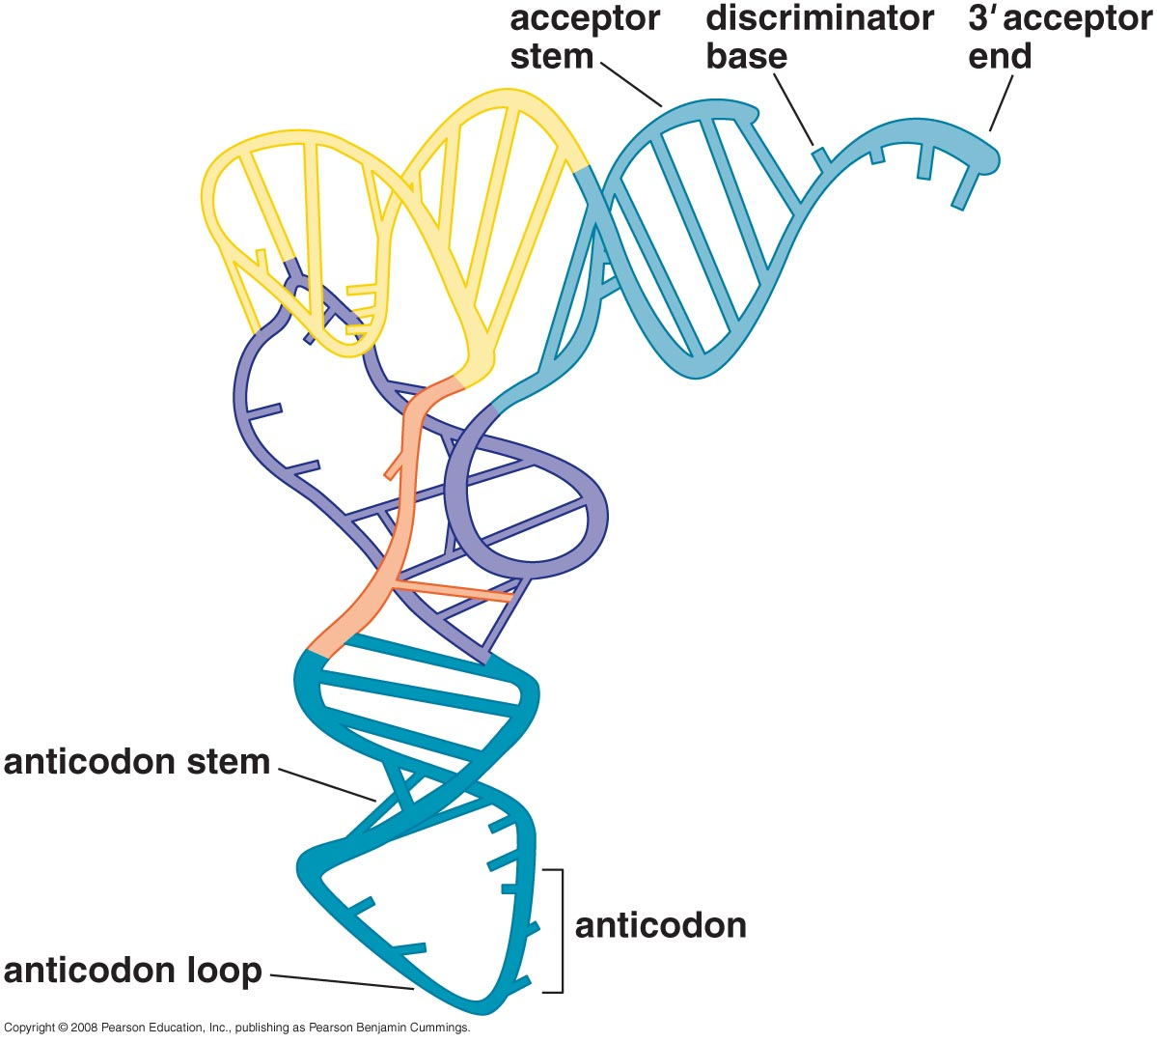
tRNA synthetases recognize unique structural features of cognate tRNAs
tRNA elements required for aminoacy-tRNA synthetase recognition

Slide 16
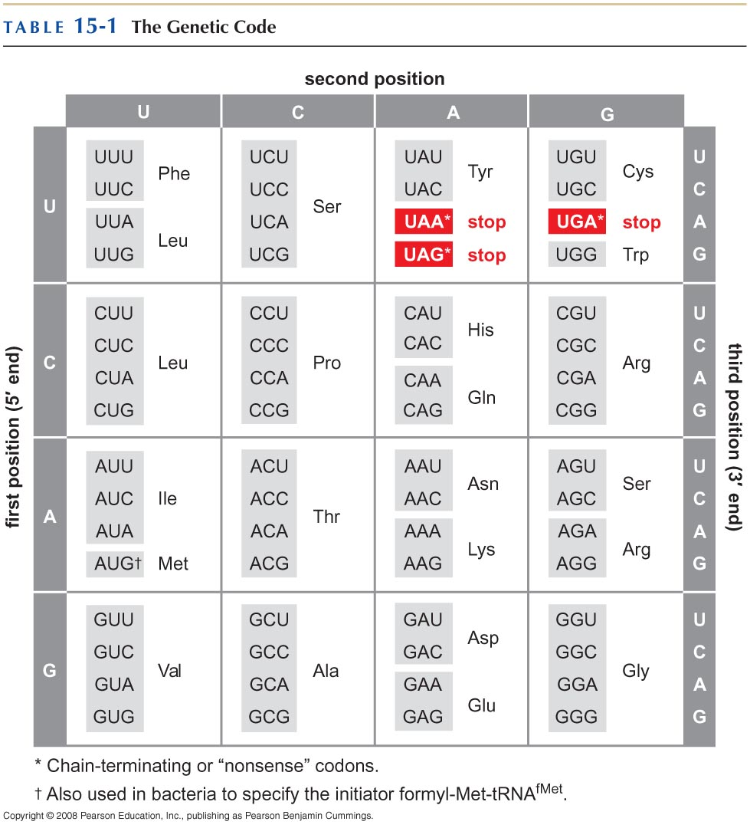

Slide 17
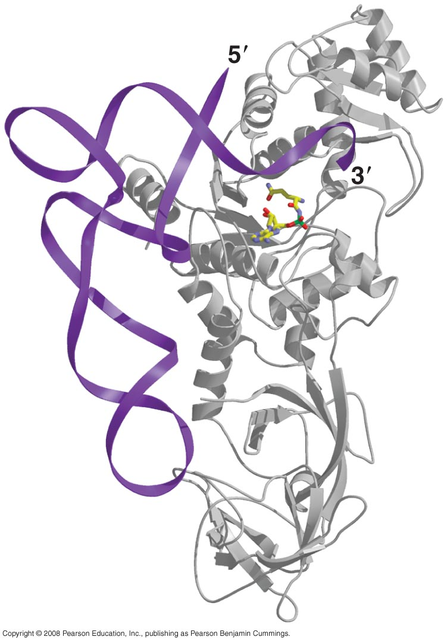
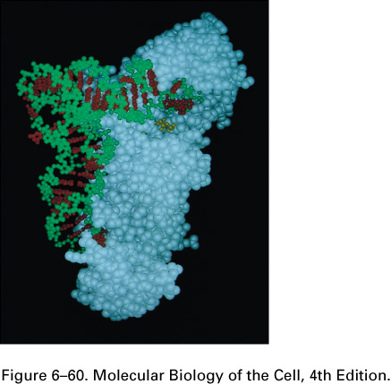
The recognition of a tRNA molecule by its aminoacyl-tRNA synthetase.
For this tRNA (tRNAGln), specific nucleotides in both the anticodon (bottom) and the amino acid-accepting arm allow the correct tRNA to be recognized by the synthetase enzyme (blue). (Courtesy of Tom Steitz.)

Slide 18
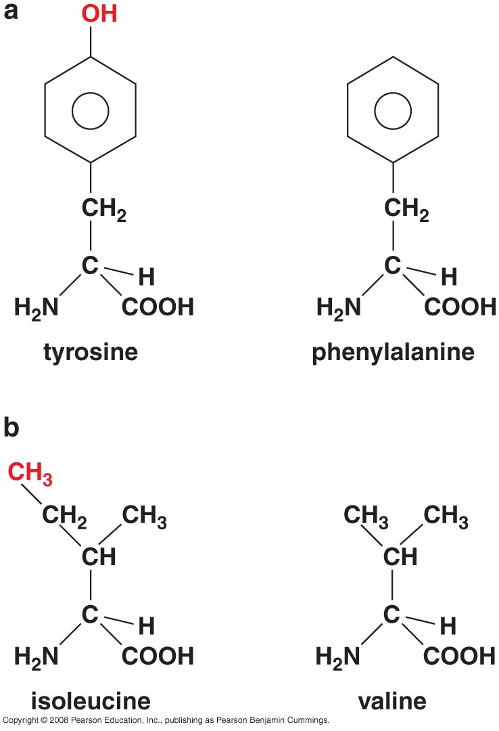
Aminoacyl-tRNA formation is very accurate

Slide 19
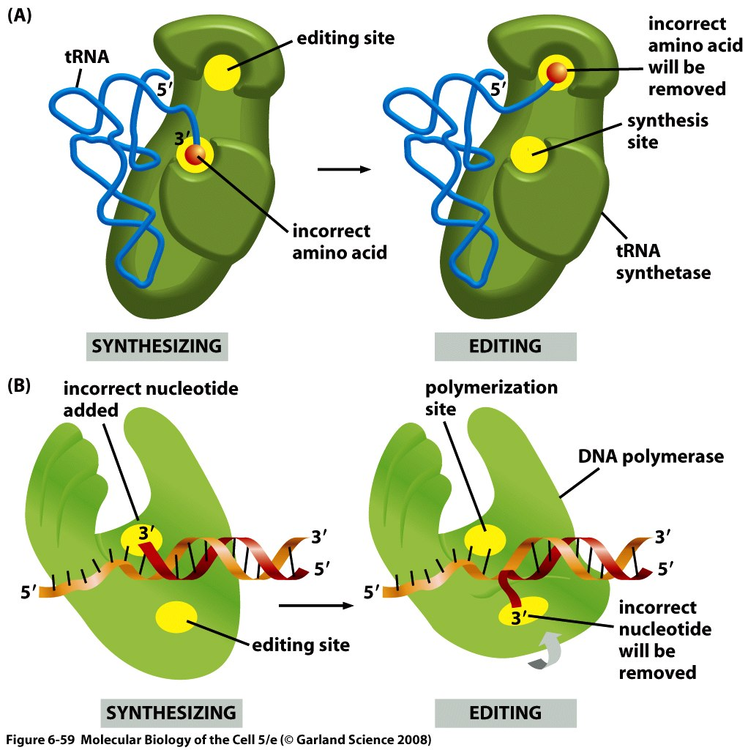
Some aminoacyl-tRNA synthetases use an editing pocket to charge tRNAs with high accuracy
Hydrolytic editing.
(A) tRNA synthetases remove their own coupling errors through hydrolytic editing of incorrectly attached amino acids. As described in the text, the correct amino acid is rejected by the editing site.
(B) The error-correction process performed by DNA polymerase shows some similarities; however, it differs so far as the removal process depends strongly on a mispairing with the template.

Slide 20
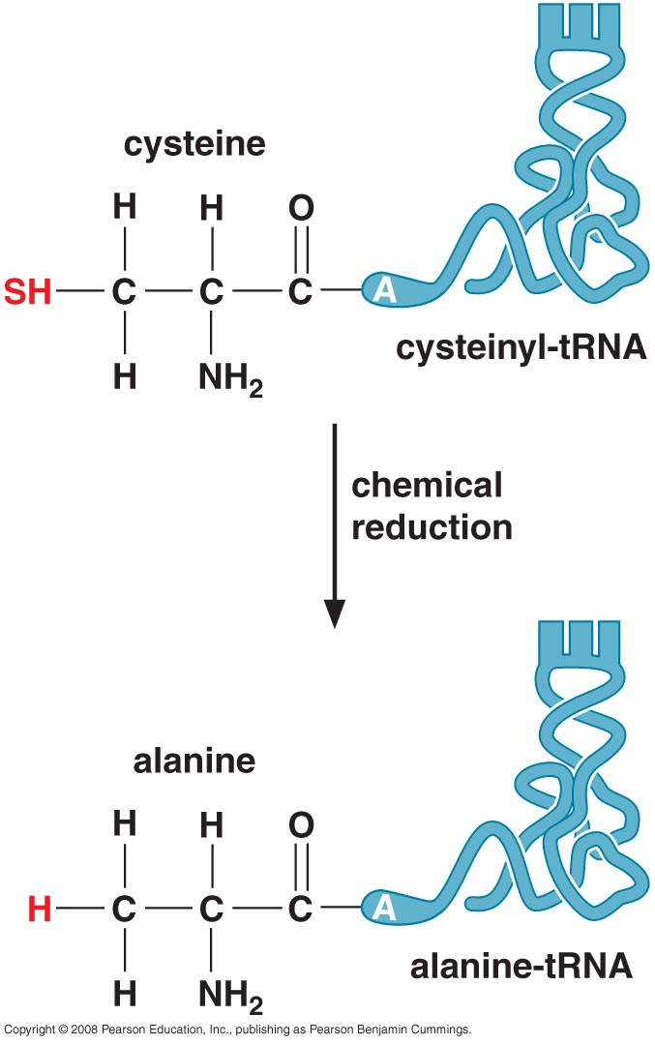
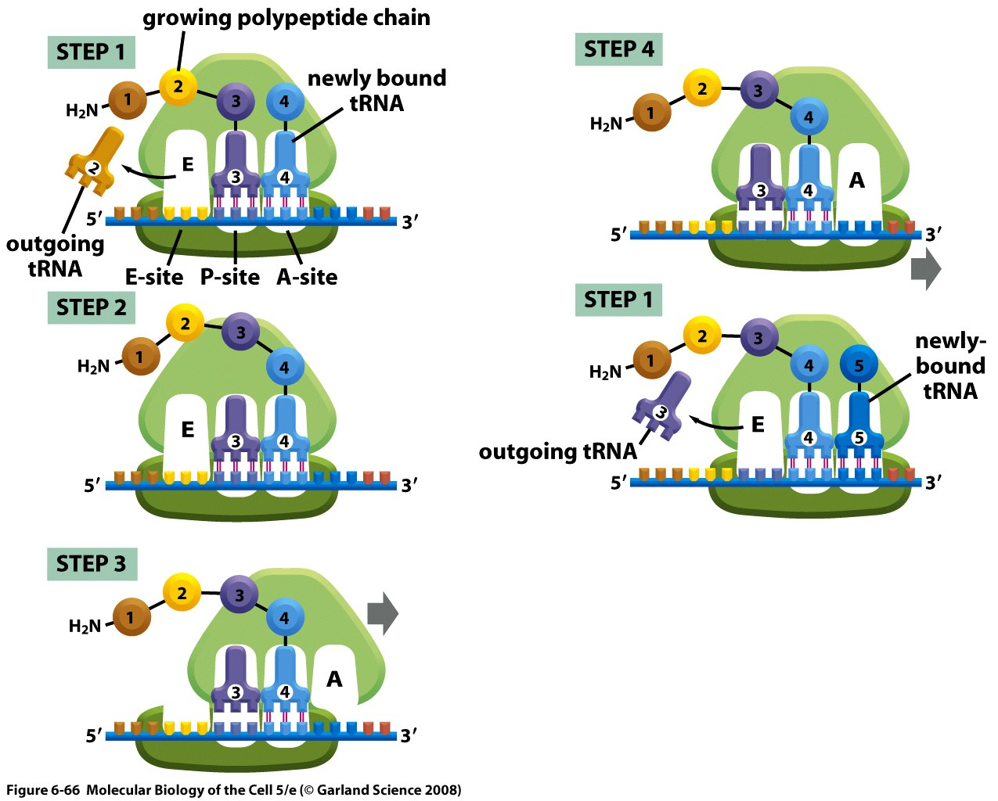
The ribosome is unable to discriminate between correctly and incorrectly charged tRNAs

Slide 21
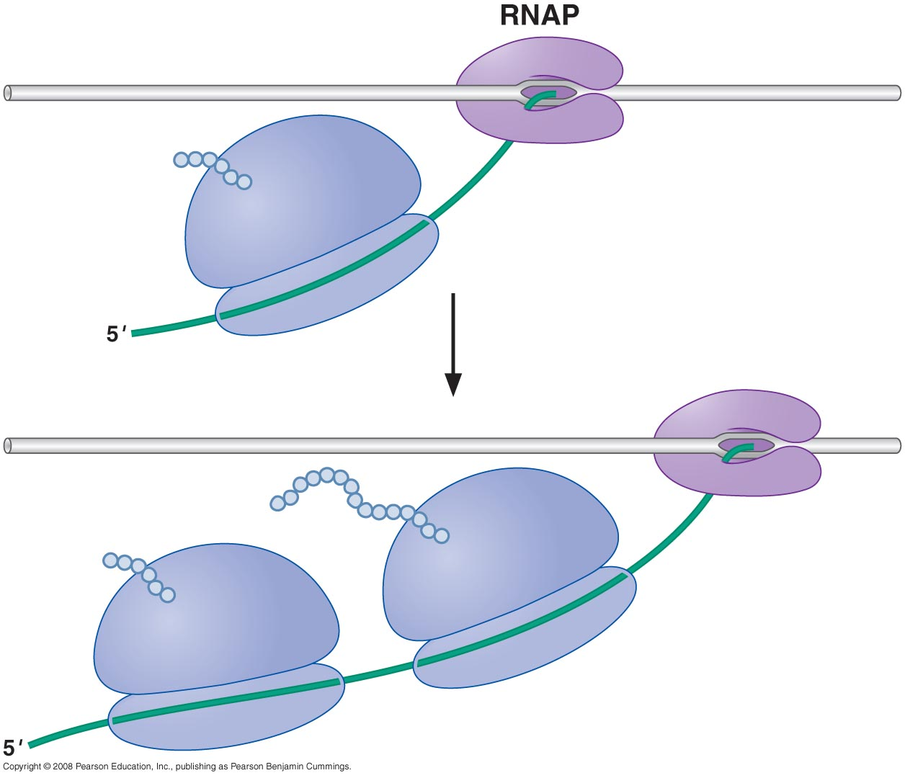
THE RIBOSOME
Prokaryotic RNAP and ribosomes at work on the same mRNA

Slide 22
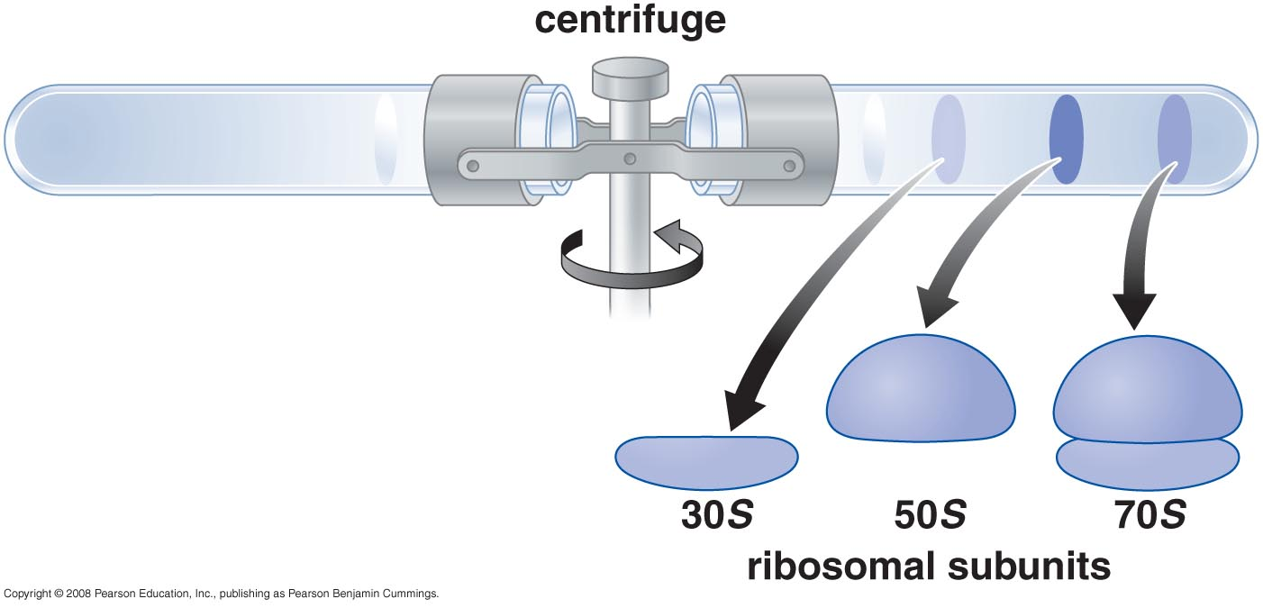
The ribosome is composed of a large and small subunit

Slide 23
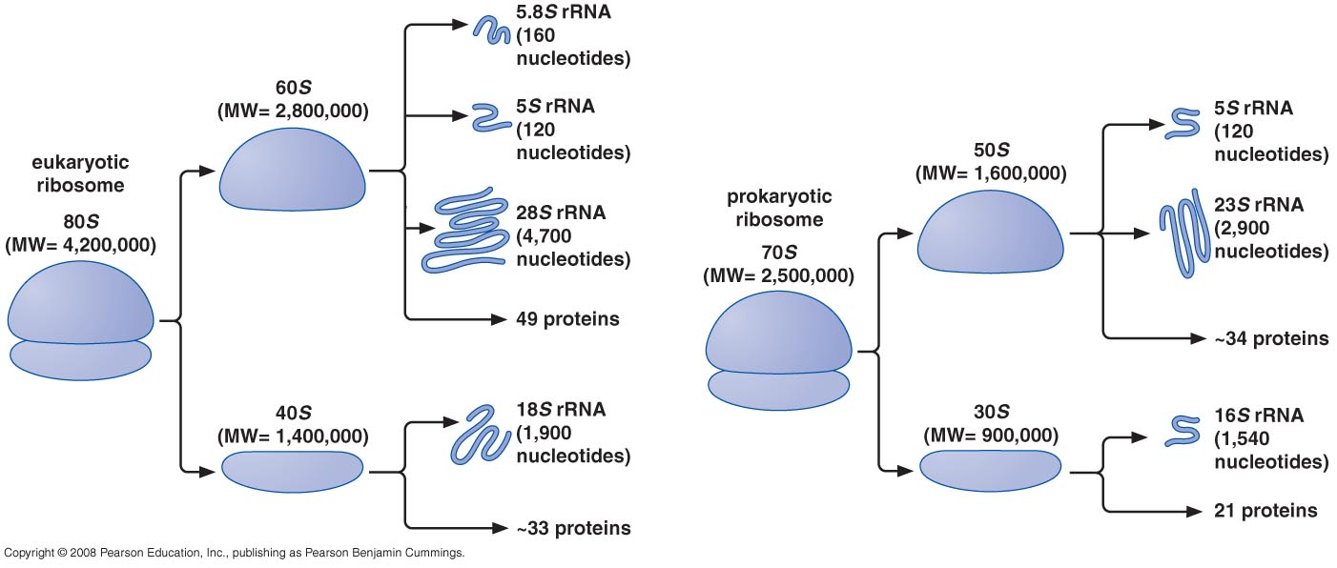

Slide 24
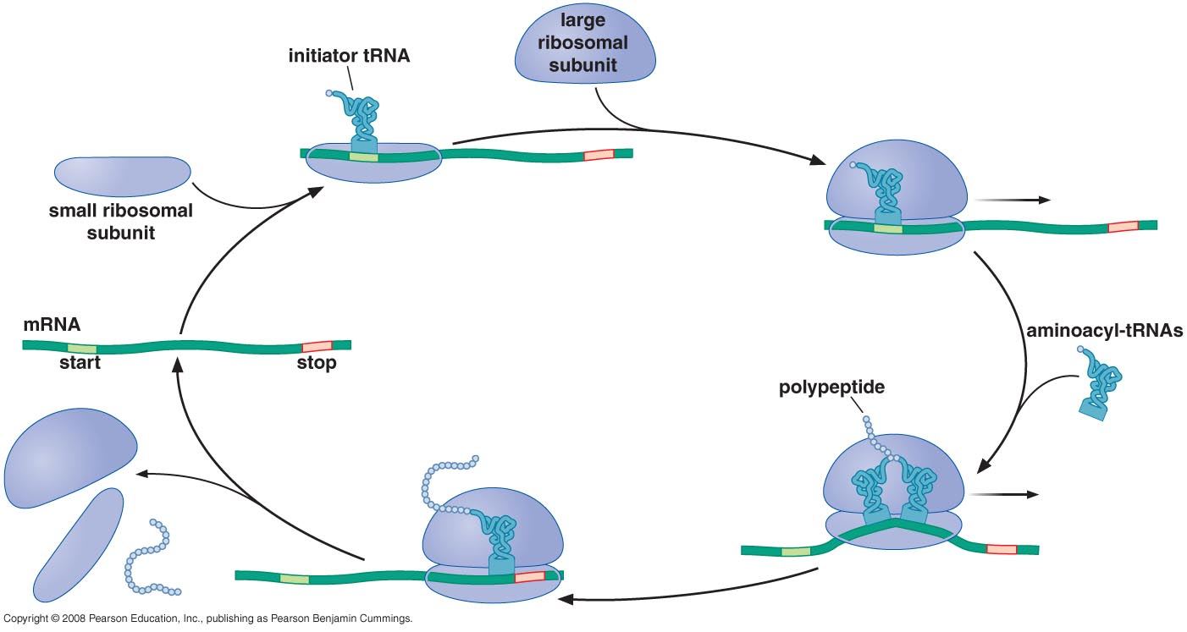
The large and small subunits undergo association and dissociation during each cycle of translation

Slide 25
Each mRNA can be translated simultaneously by multiple ribosomes

Slide 26
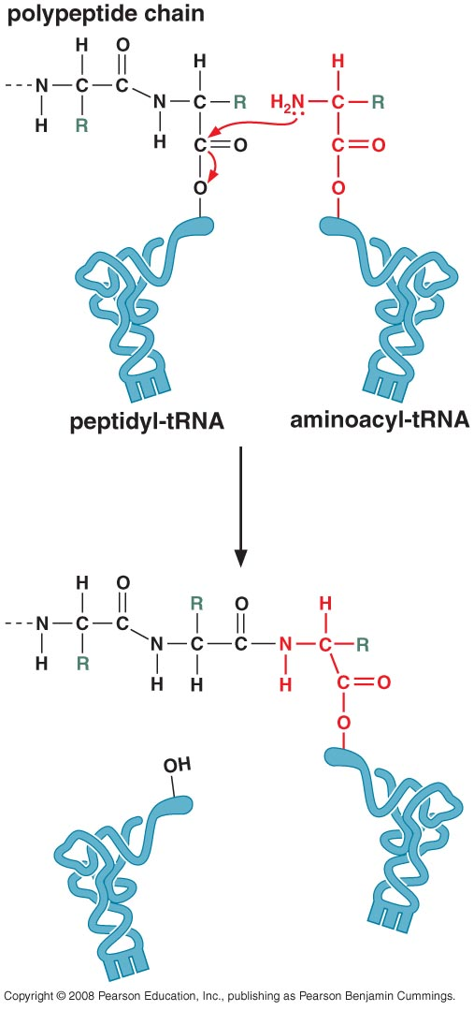
New amino acids are attached to the carboxyl terminus of the growing peptide chain

Slide 27
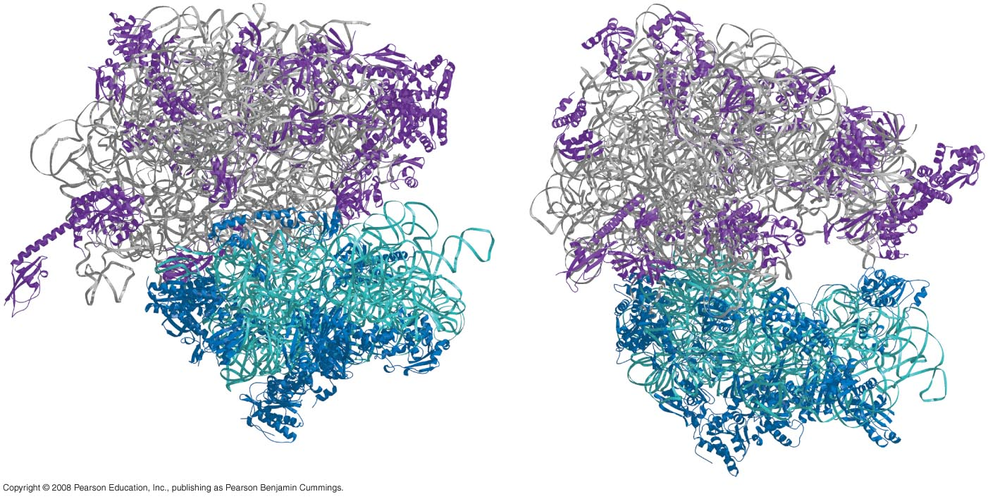
Ribosomal RNAs are both structural and catalytic determinants of the ribosome
Two views of ribosome

Slide 28
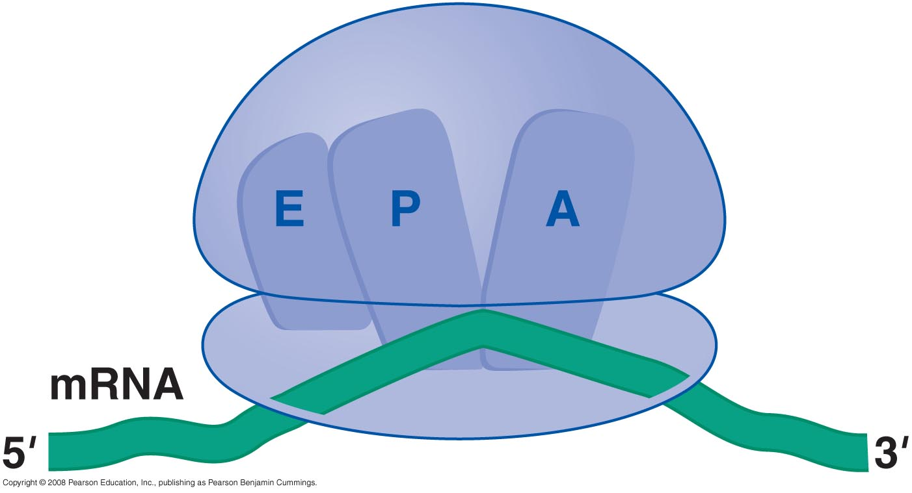
The ribosome has three binding sites for tRNA

Slide 29
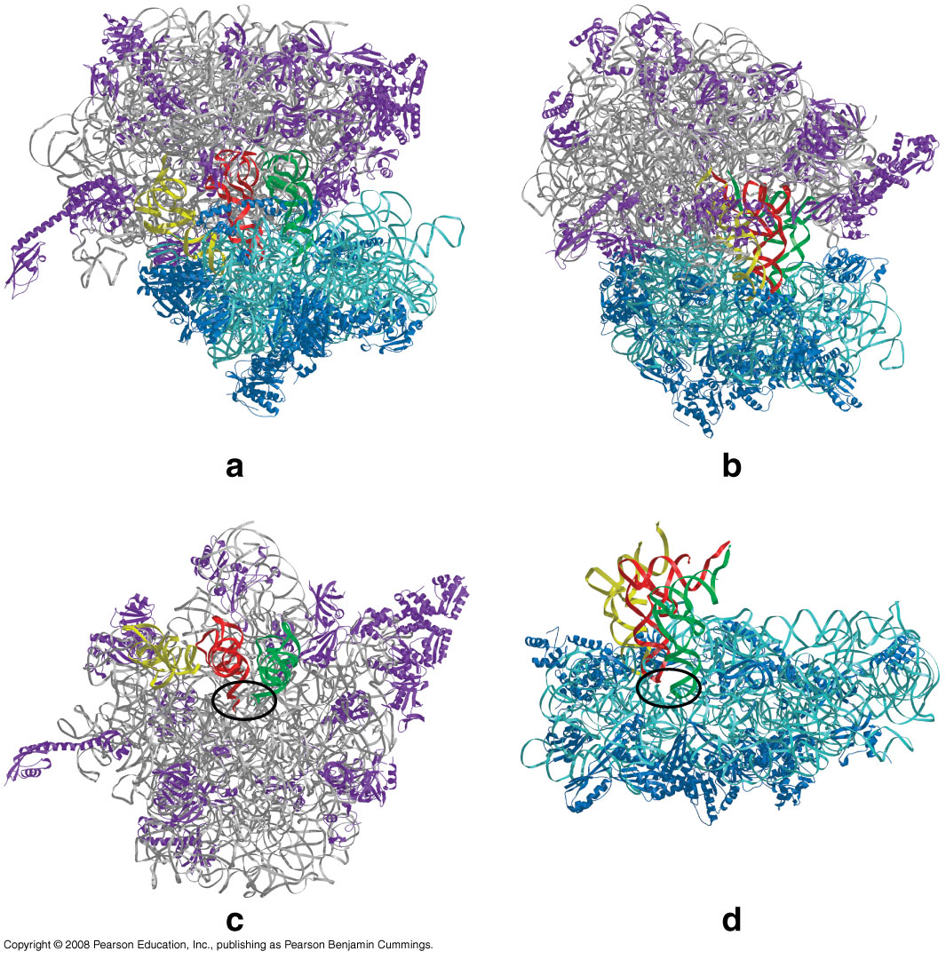
Views of 3-D structure of the ribosome including three bound tRNAs

Slide 30
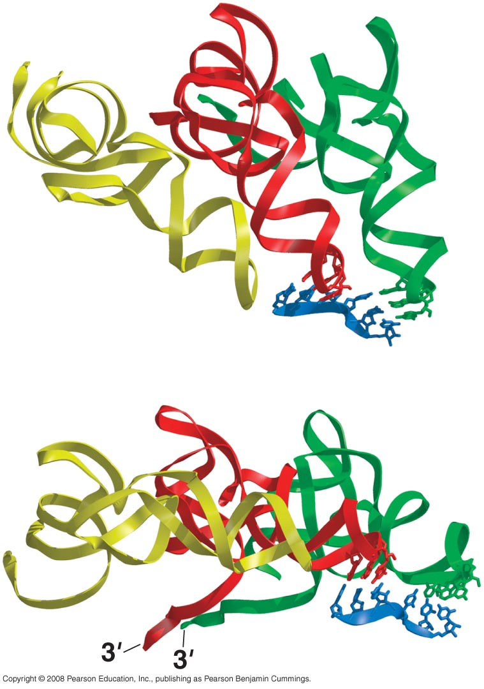
Channels through the ribosome allow the mRNA and growing polypeptide to enter and/or exit the ribosome
Interactions of tRNAs with mRNA

Slide 31
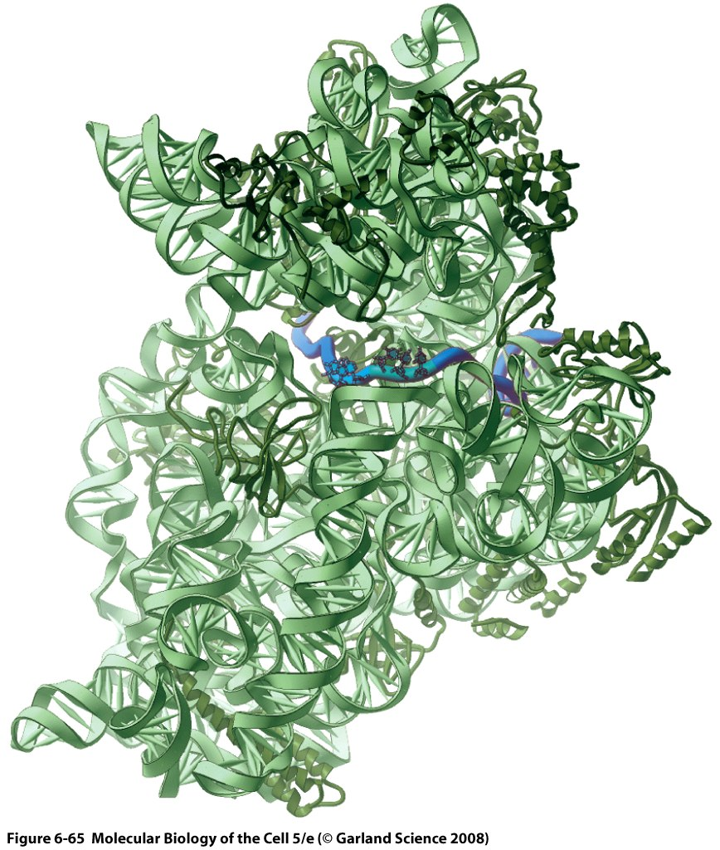
The path of mRNA through the small ribosomal subunit

Slide 32
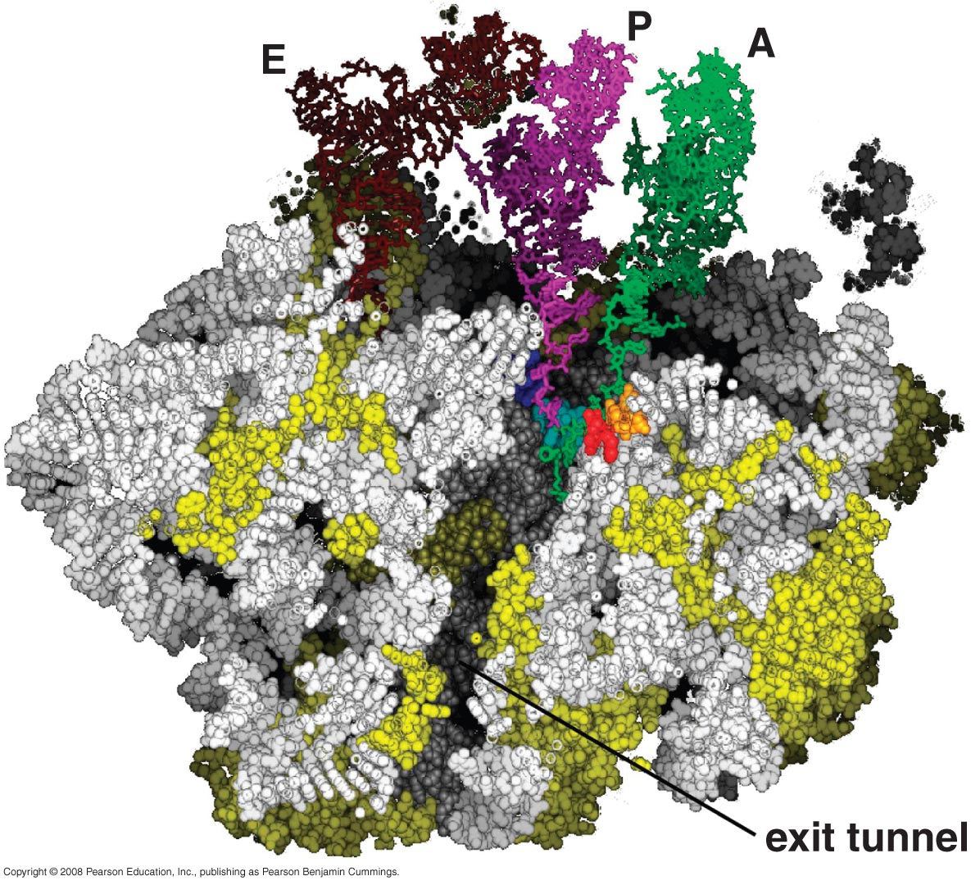
The polypeptide exit tunnel

Slide 33
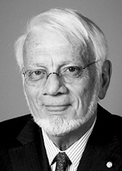
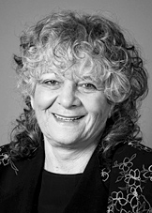
The Nobel Prize in Chemistry 2009
"for studies of the structure and function of the ribosome"
Venkatraman Ramakrishnan | Thomas A. Steitz | Ada E. Yonath
1/3 of the prize | 1/3 of the prize | 1/3 of the prize
United Kingdom | USA | Israel
MRC Laboratory of Molecular Biology Cambridge, United Kingdom | Yale University New Haven, CT, USA; Howard Hughes Medical Institute | Weizmann Institute of Science Rehovot, Israel
b. 1952 (in Chidambaram, Tamil Nadu, India) | b. 1940 | b. 1939

Slide 34
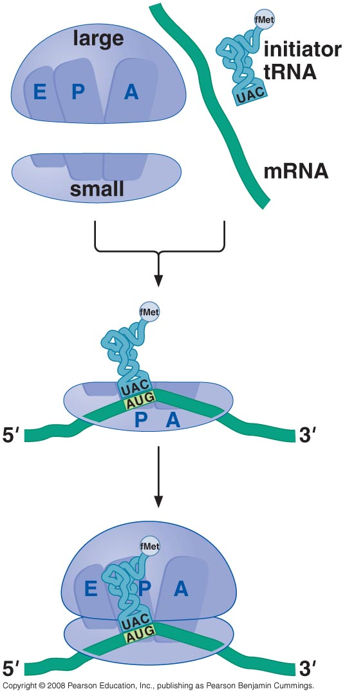
INITIATION OF TRANSLATION

Slide 35
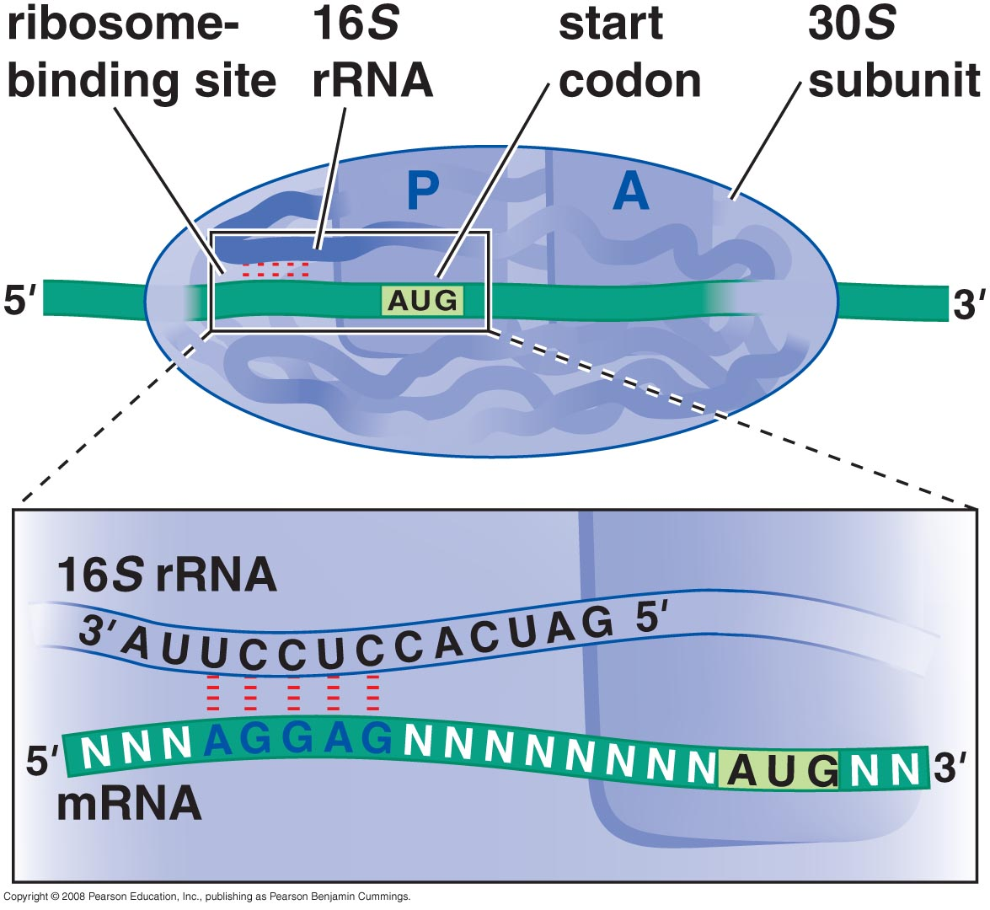
Prokaryotic mRNAs are initially recruited to the small subunit by base pairing to rRNA

Slide 36
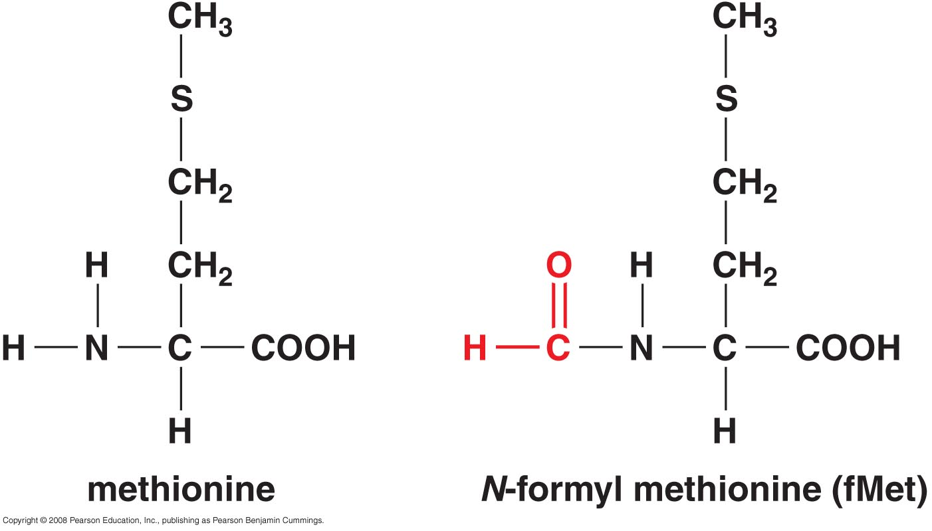
A specialized tRNA charged with a modified methionine binds directly to prokaryotic small subunit

Slide 37
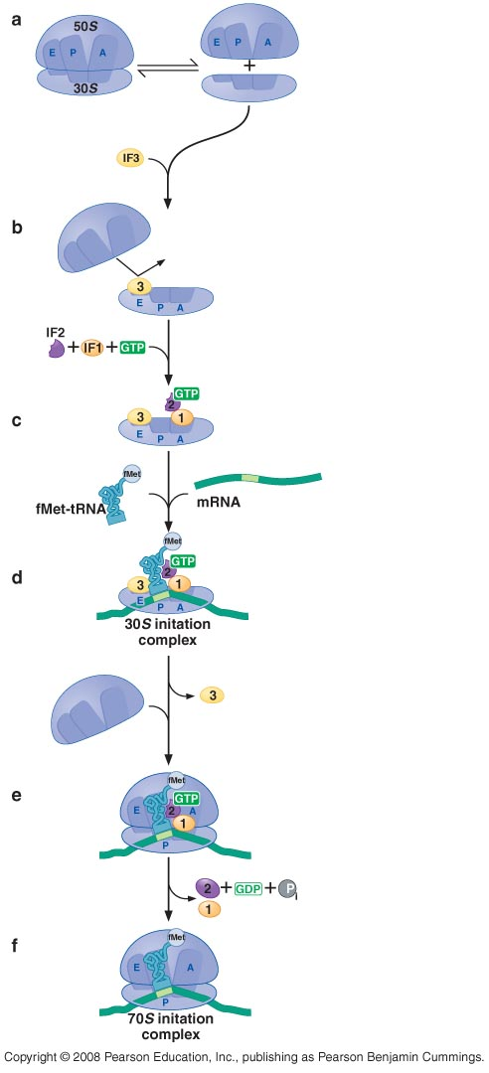
Three initiation factors direct the assembly of an initiation complex that contains mRNA and the initiator tRNA

Slide 38
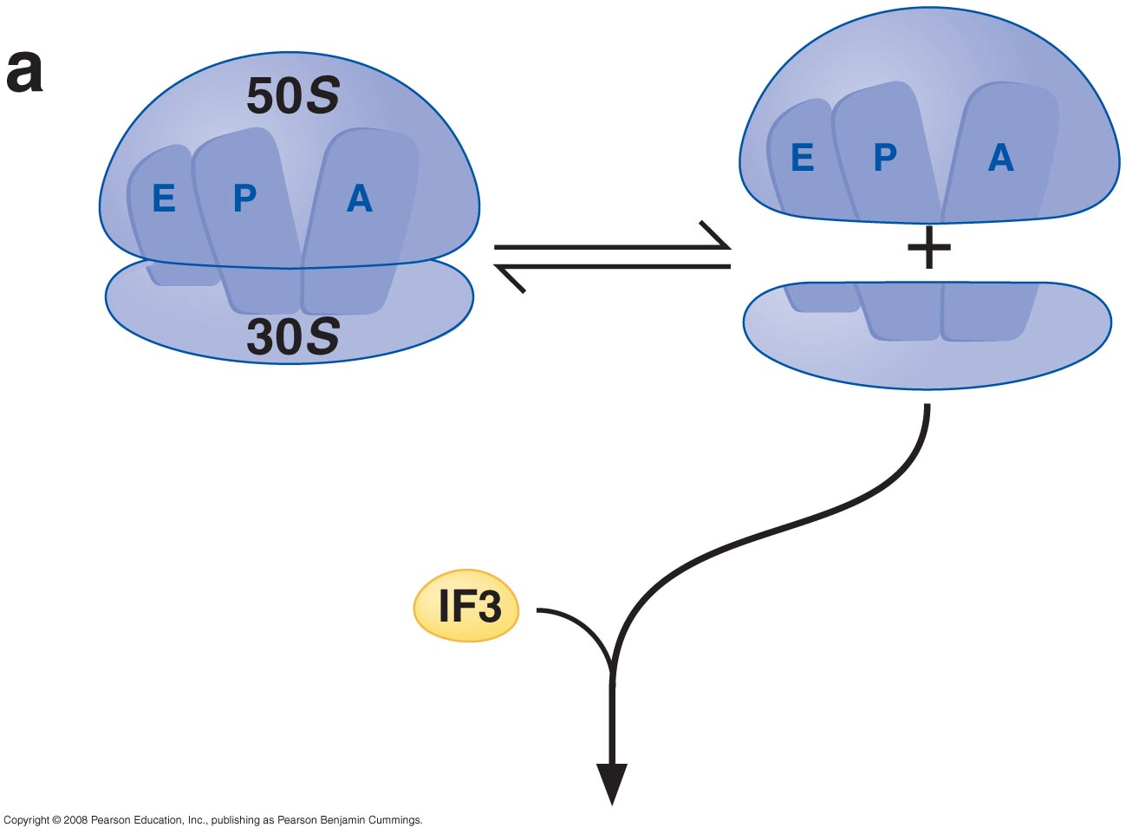
14_Figure25a.jpg

Slide 39
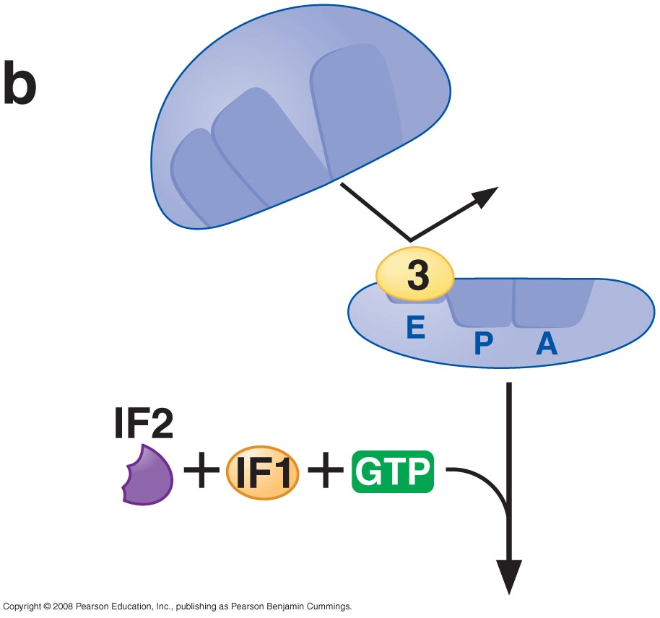
14_Figure25b.jpg

Slide 40
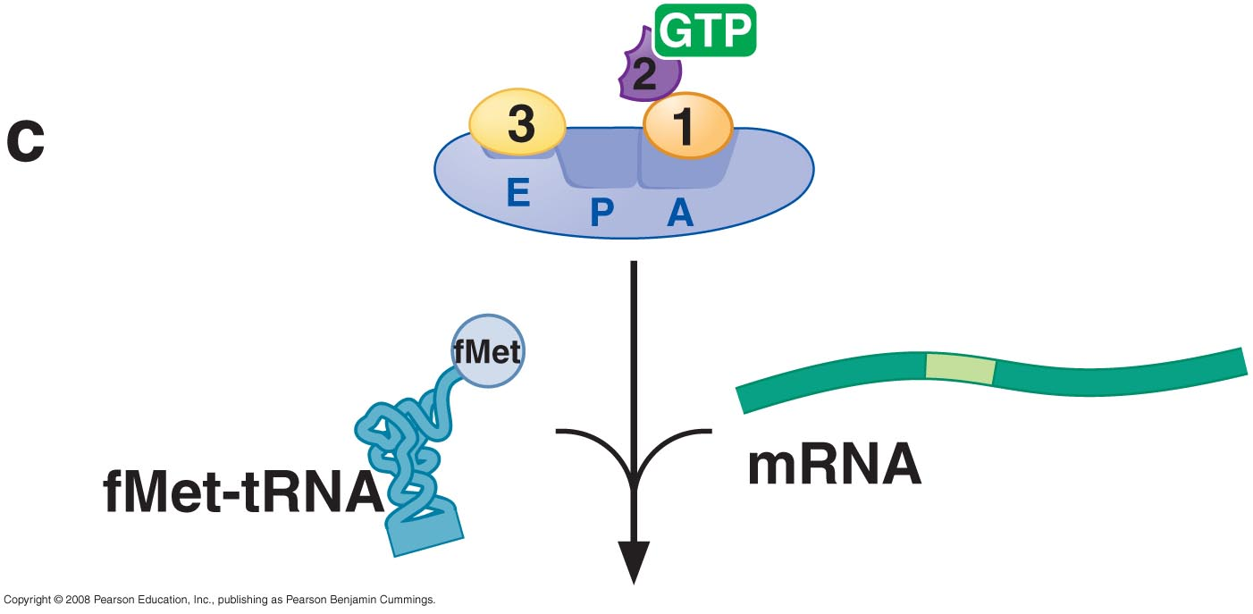
14_Figure25c.jpg

Slide 41
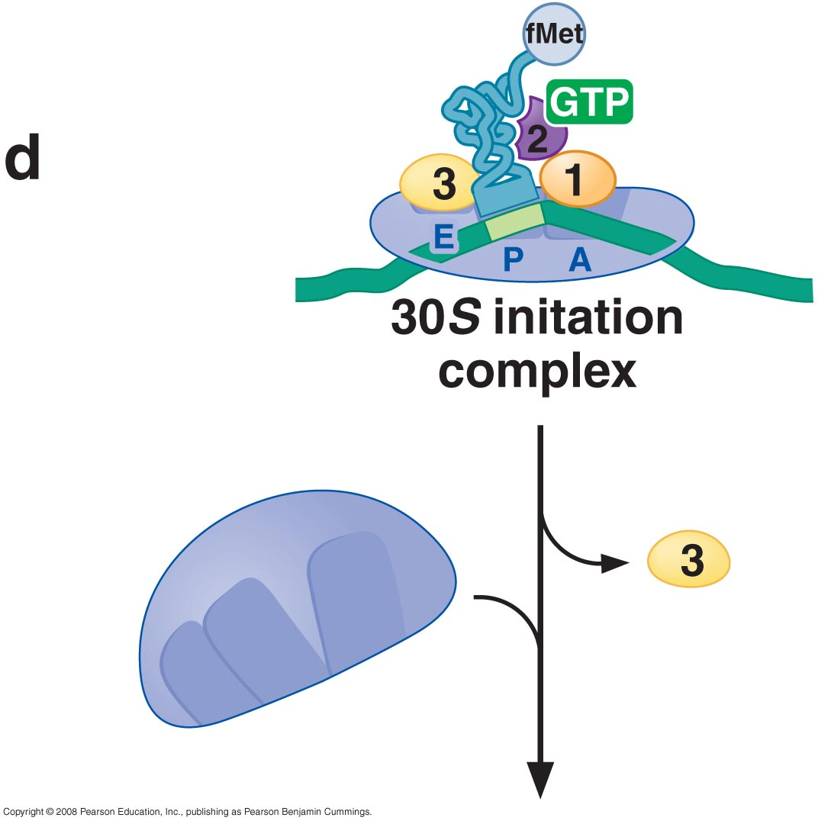
14_Figure25d.jpg

Slide 42
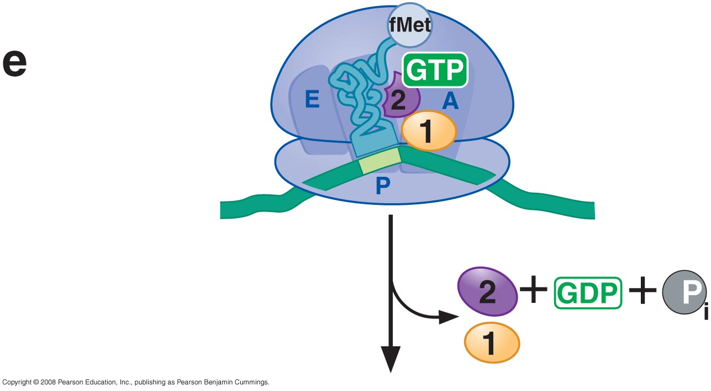
14_Figure25e.jpg

Slide 43
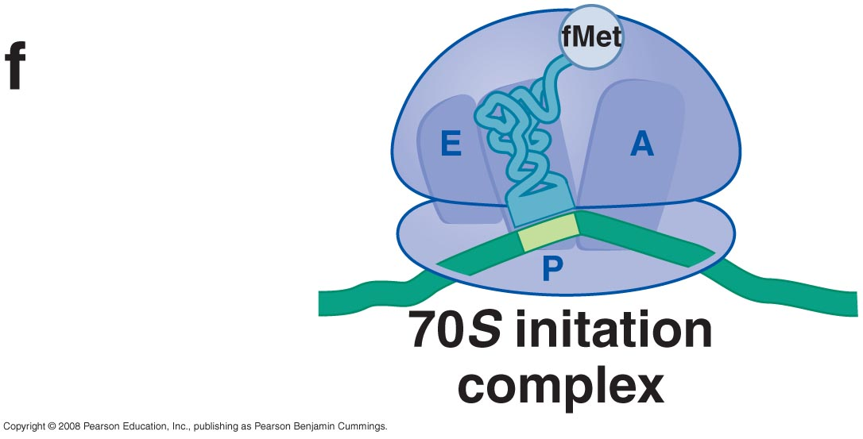
14_Figure25f.jpg

Slide 44
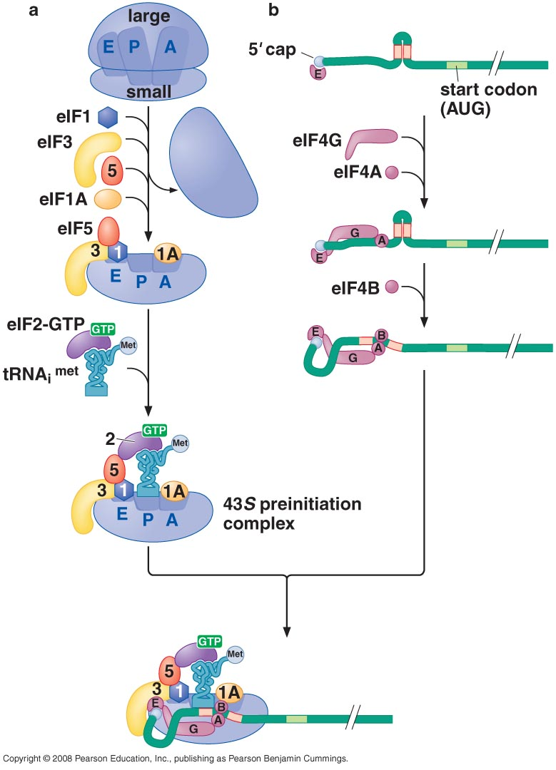
Eukaryotic ribosomes are recruited to the mRNA by the 5’ cap

Slide 45
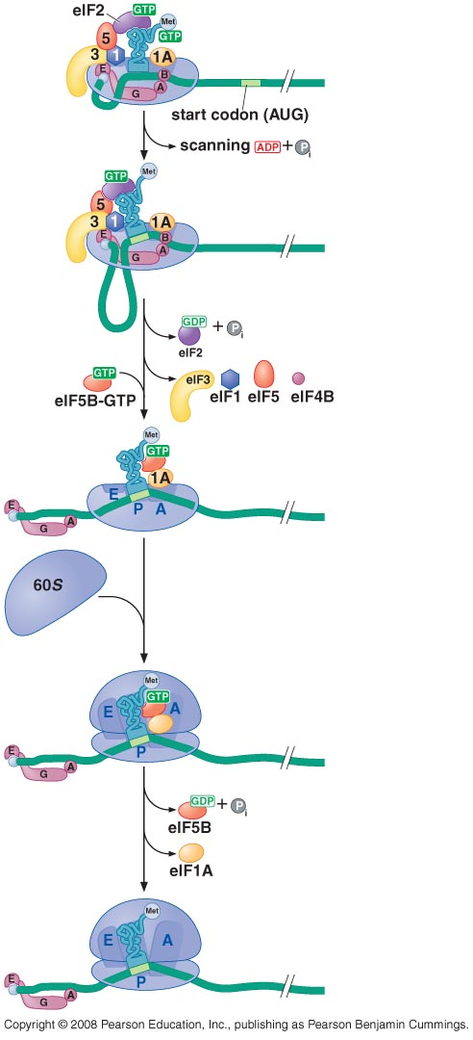
The start codon is found by scanning downstream from the 5’ end of the mRNA

Slide 46
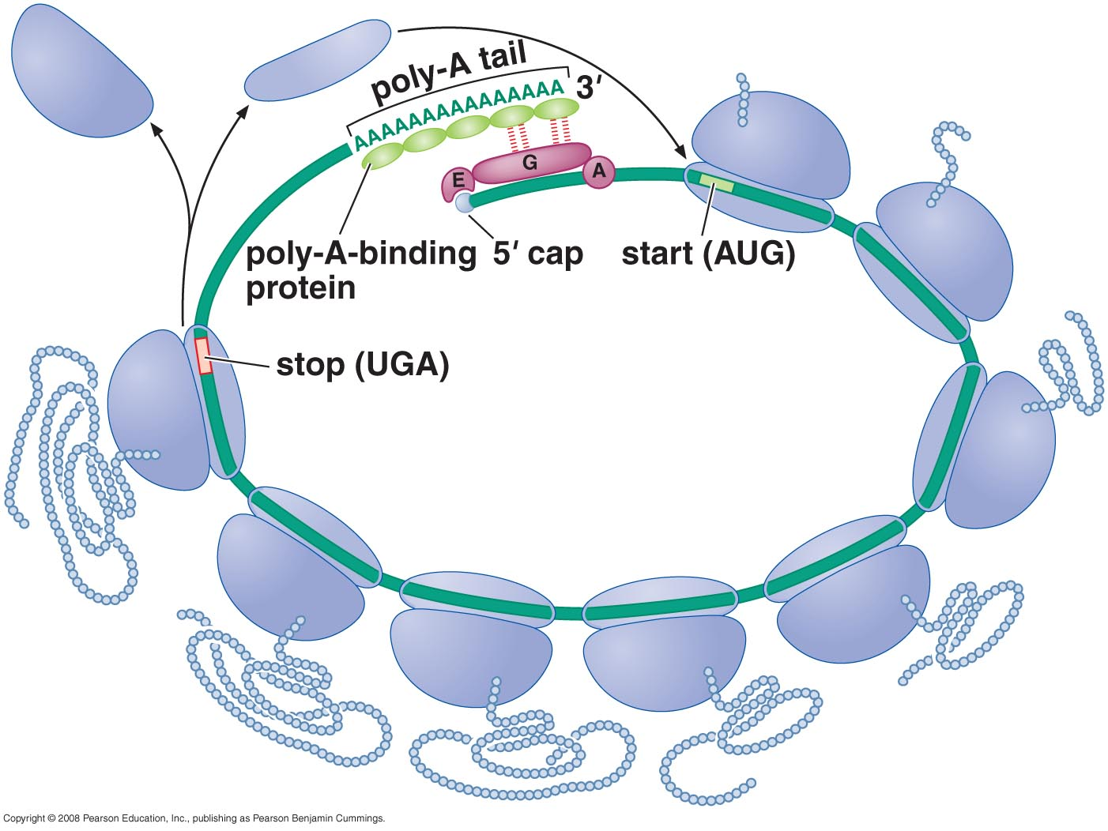
Translation initiation factors hold eukaryotic mRNAs in circles

Slide 47
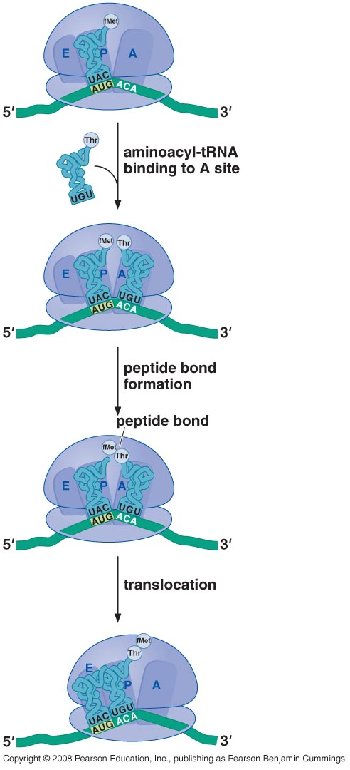
TRANSLATION ELONGATION

Slide 48
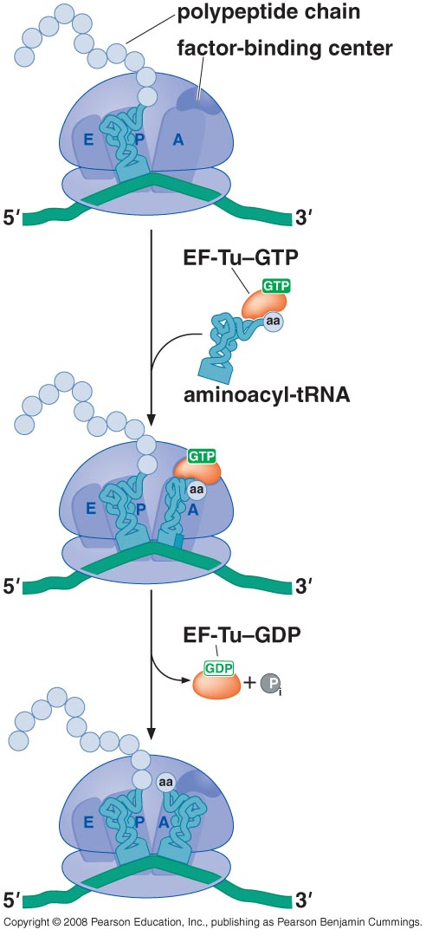
Aminoacyl-tRNAs are delivered to the A site by elongation factor EF-Tu

Slide 49
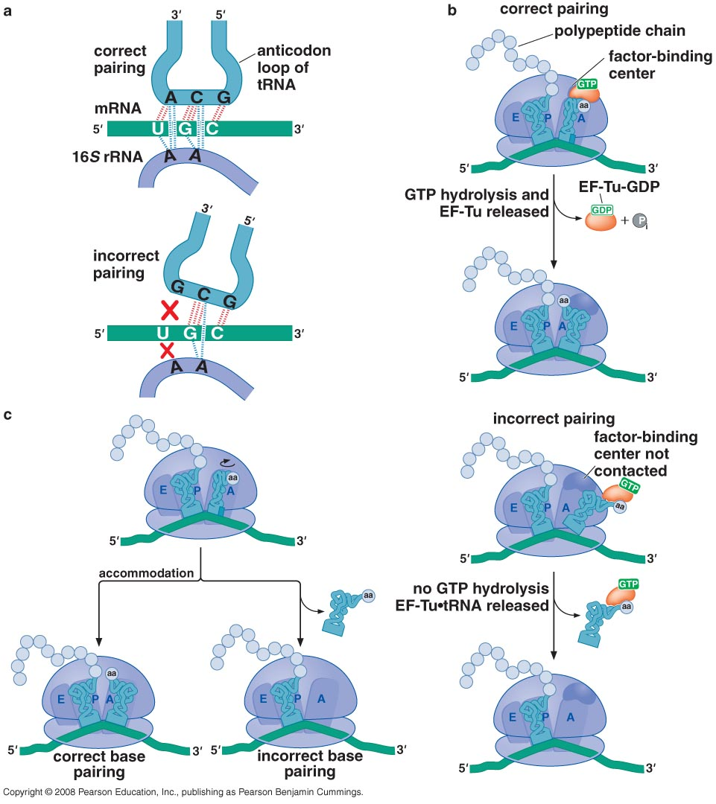
The ribosome uses multiple mechanisms to select against incorrect aminoacyl-tRNAs

Slide 50
The ribosome is a ribozyme
RNA surrounds the peptidyl transferase center of the large ribosomal subunit

Slide 51
Proposed role for the 2’-OH of the P site tRNA in peptide bond formation

Slide 52
Peptide bond formation and the elongation factor EF-G drive translocation of the tRNAs and the mRNA
EF-G drive translocation by displacing the tRNA bound to the A site

Slide 53
Structural comparison of EF-Tu-tRNA and EF-G

Slide 54
EF-TU-GDP and EF-G-GDP must exchange GDP for GTP prior to participating in a new round of elongation
A cycle of peptide bond formation consumes two GTPs and one ATP

Slide 55
TERMINATION OF TRANSLATION
Release factors terminate translation in response to stop codon

Slide 56
Short regions of class I release factors recognize stop condons and trigger release of the peptide chain
3-D structures of RF1 bound to the ribosome

Slide 57
Comparison of the structures of RFI to a tRNA

Slide 58
GDP/GTP exchange and GTP hydrolysis control the release of the class II release factor

Slide 59
The ribosome recycling factor (RRF) mimics a tRNA to stimulate the release of tRNA and mRNA from a terminated ribosome

